Slide 1
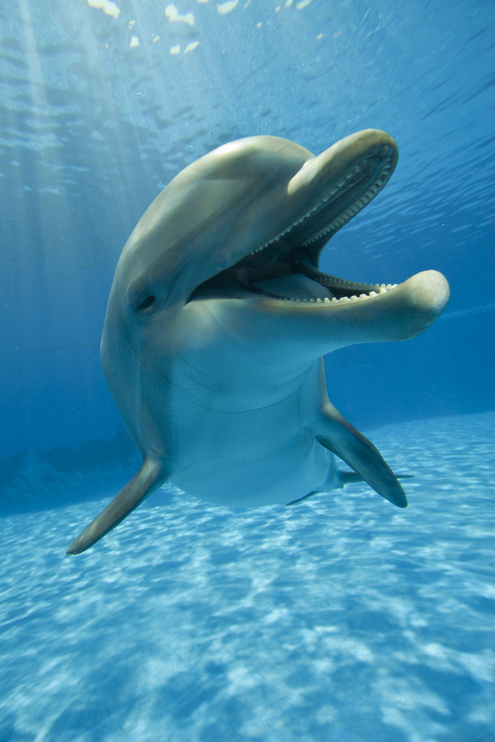
General Association Meeting
Foothill Elementary PTA
2 October 2014

Slide 2
Introductions

Slide 3
Meeting minutes from May 23, 2014
Summary:
Meeting minutes from 04/28/14 were adopted.
Affirmed Iruna Sesma as 2014-2015 Secretary, Shawna Ballard as 2014-2015 Parliamentarian, and Denise Zarins as 2014-2015 Executive Vice President.
Finally achieved full budget.
Released $33,000 in spending for the summer and early Fall 2014 Programs and Classroom Grants, adopted final budget, ratified checks 5726-5836.
Need a motion to adopt the May 23rd, 2014 minutes, either as written or as corrected.

Slide 4
Programs 2014-2015
Year-Round Programs:
Art Docent
ABC Readers / Project Cornerstone
Playground Pals Bus Stop
School-wide Events:
Book Fair (November 3rd-7th)
Staff Holiday Luncheon (December 11th)
Junior Achievement Day (February)
Science Day (March 10th)
Staff Appreciation Week (May 4th-8th)
Field Day (June)
Special Programs and Events:
Fall Musical (Sept. through Nov. Performances Nov. 14th and 15th)
Fall Family Fun Night (October 18th)
Holiday Ceramic Gift (December)
Spelling Bee (January)
Math Olympiad (October through April)
Variety Show (April, Performance April 30th)
International Night (Spring)
Need a motion to adopt the 2014-2015 Programs and Events.

Slide 5
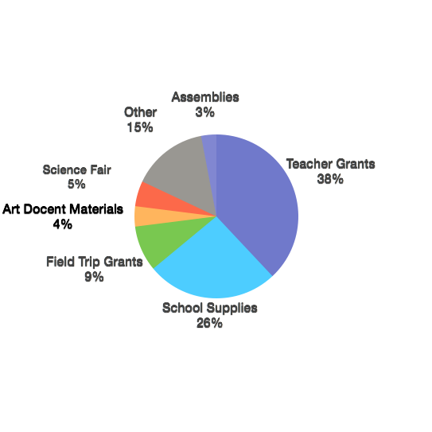
Budget and Ratifications 2014-2015
Need a motion to adopt the Final 2013-2014 Budget.
Need a motion to ratify checks 5726 through 5856.
Need a motion to adopt the 2014-2015 Budget
Need a motion to ratify checks 5857 through 5864.

Slide 6
Release of Funds through January 2015
Release of funds September EB and Oct GA Meetings
Bookfair |  | 5000
Adult Community Nights |  | 600
Art Docent Materials |  | 2000
Assemblies |  | 750
Directory and Finder |  | 1800
Giving from the Heart |  | 130
Math Olympiad |  | 1300
Playground Pals |  | 1000
Principal's Discretionary Spending |  | 500
Project Cornerstone |  | 750
PTA Meetings |  | 200
Science Fair |  | 2500
Staff Holiday Lunch |  | 300
Teacher Substitutes |  | 400
PTAEZ, CAPTA, Taxes |  | 350
Ceramic Gift |  | 600
Spelling Bee |  | 200
Insurance |  | 250
Total |  | 18630
Need a motion to release these funds.

Slide 7
Announcements
Next meeting: January TBA
Ed100
Website – PTA Common Core

